Slide 1
Comp2411 Database system
Assignment 2
(Report, demo and user manual)
Student course registration system
Lee Ming Hei 18039515D
Lee Minkyung 17087708D
Sweta Das 18080395D

Slide 2
Brief Introduction for this project
The objective of this project is to use a java program to create an interface for users to edit, access and manage a database.
Work we should do:
Running SQL with java language
Using java commands to create an interface
Create methods for edit/access the database

Slide 3
Brief Introduction for this project
Our system mainly uses command interface, with simple input, only asking for number for option selections, and simple text for modifying the information for the database.
Features of our system:
User can input a number for choosing which method to be called
The inputs needed are simple
There are list which will be shown after methods called, so that the users can view the change in the database.
This system is user-friendly for user if he/she can follow the instructions

Slide 4
Brief Introduction for this project
The difficulties we overcame:
Combine the SQL and java language to enable the program to edit/view the database
We found out the right SQL commands for each part of the question of this project
We created a simple interface, so that the user can observe changes in the database easily
After we overcome these challenges, we could do each part with the right SQL commands and methods.

Slide 5
User manual for part a)
(a) A user should be able to login to the system as a student or an administrator.
Input 1 to login to the system as student
Input 2 to login to the system as administrator
If you select 1, input the student id for ID and student name for password
If you select 2, input the following id and password below. (administrator id : admin, password: 123456)
If student id or password is wrong, the user need to input them again

Slide 6
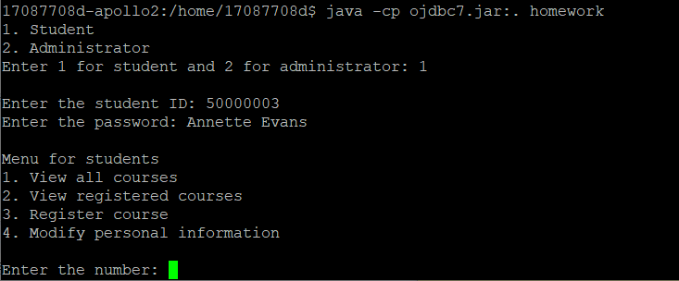
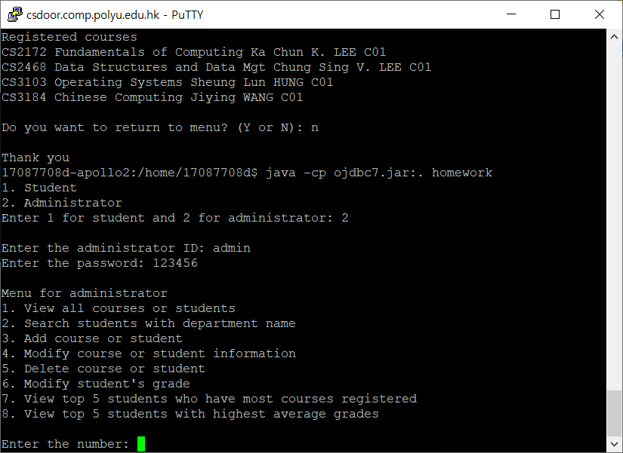
Demo for part (a)
Login
For student,
Login as “50000004”
For admin,
Login as “admin”

Slide 7
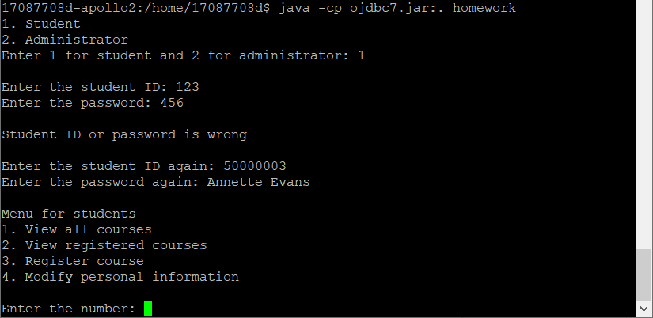
Demo for part (a)
Login error
For student,
The user can not login when the id or password is wrong.

Slide 8
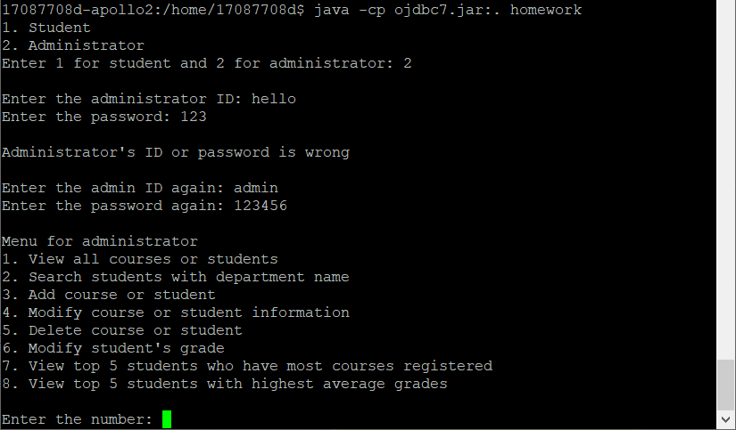
Demo for part (a)
Login error
For administrator,
The user can not login when the id or password is wrong.

Slide 9
User manual for part b)
(b) A student should be able to list all the courses in the system.
Login to the system as student (Input 1 when the program starts)
Select the option 1 to view the list of courses (Input 1)
The output will be showed
Input ‘Y’ to return to the menu for student.

Slide 10
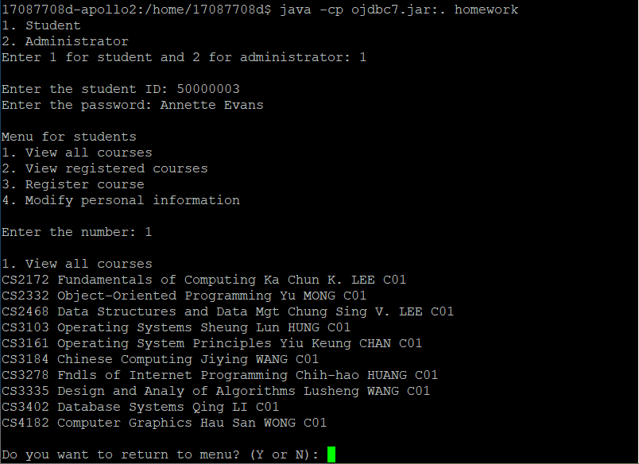
Demo for part (b)
If the user select option 1, the program shows all the courses.

Slide 11
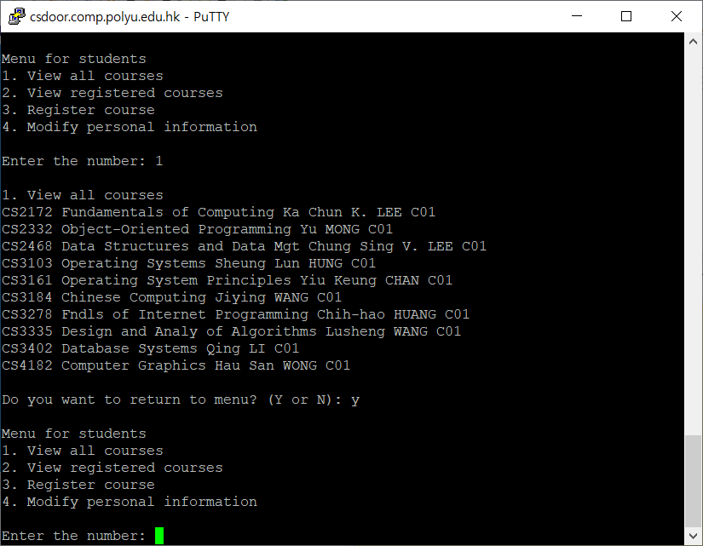
Demo for part (b)
If the user input Y to return to menu, the program returns to ‘menu for student’

Slide 12
User manual for part c)
(c) A student should be able to list all the courses that he/she has registered.
Login to the system as student (Input 1 after enter the program)
Select the option 2 to view the list of courses student has registered (Input 2)
The output will be showed
Input ‘Y’ to return to the menu for student.

Slide 13
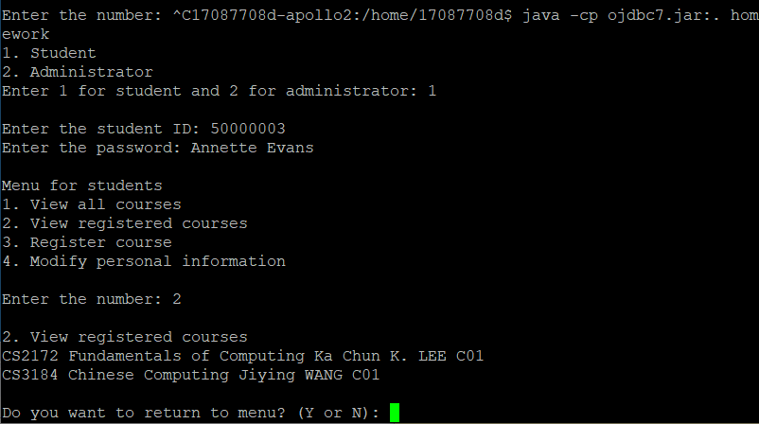
Demo for part (c)
If the user select option 2, the program show all the courses that user/student registered.

Slide 14
User manual for part d)
(c) A student should be able to register courses in the system.
Login to the system as student (Input 1 when the program starts)
Select the option 3 to register courses (Input 3)
The program shows the list of courses
Input the course ID - If course ID is wrong or the course is already registered, the user need to input the course ID again
Input -1 if the user wants to stop
The output will be showed
Input ‘Y’ to return to menu for student

Slide 15
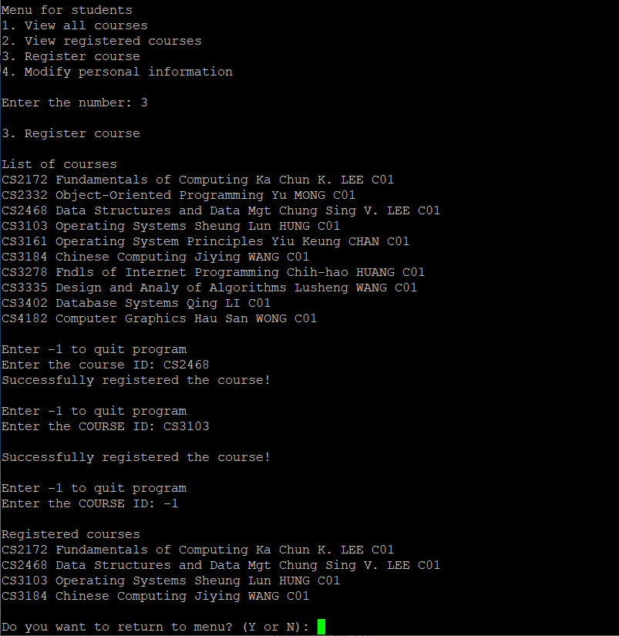
Demo for part (d)
If the user select option 3, the program asks to input course ID.
When CS2468 and CS3103 are entered, they are registered successfully.
When the user input ‘-1’, the program asks whether user wants to return to menu

Slide 16
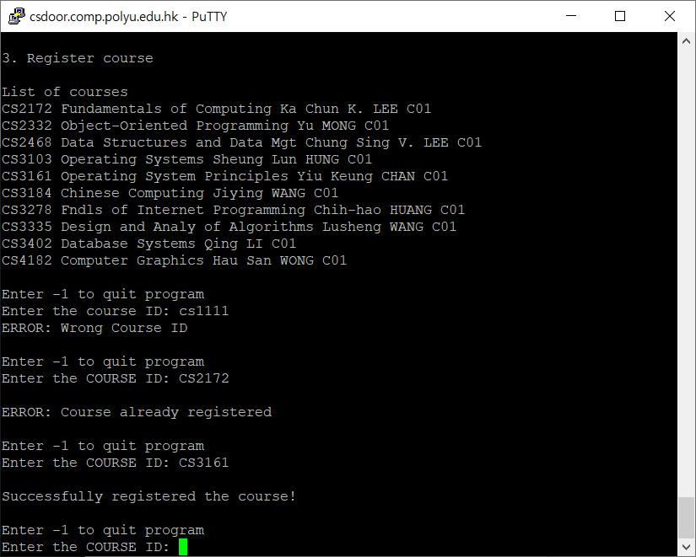
Demo for part (d)
Errors)
If the user input course ID (cs1111) which does not exist, it shows error message.
If the user input course ID (cs2172) which is already registered, it shows error message.

Slide 17
User manual for part f)
(f) An administrator should be able to list all the courses and students in the system.
The output of part (f) should be a table for all information of courses and students.
SQL should be
SELECT * FROM COURSES;
SELECT * FROM STUDENTS;

Slide 18
User manual for part f)
To show the output of part (f):
Log in the system as admin ( Input 2 after enter the program)
(the id : admin, password: 123456)
Select the option 1 to view the list of courses or students
Input 1 for the list of Courses, 2 for the list of Students
The output will be showed

Slide 19
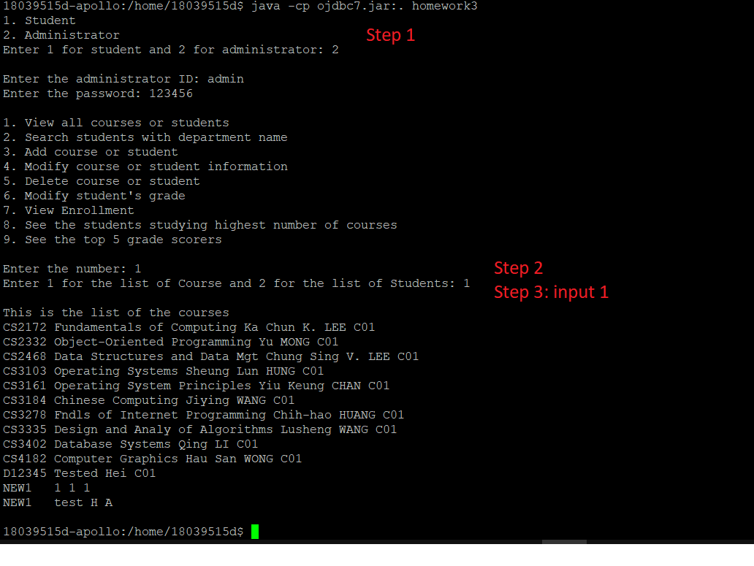
Demo of part (f)
We input 1 in this case, to show the list of course
If we input “2” in step 3,
The list of Students will be showed.

Slide 20
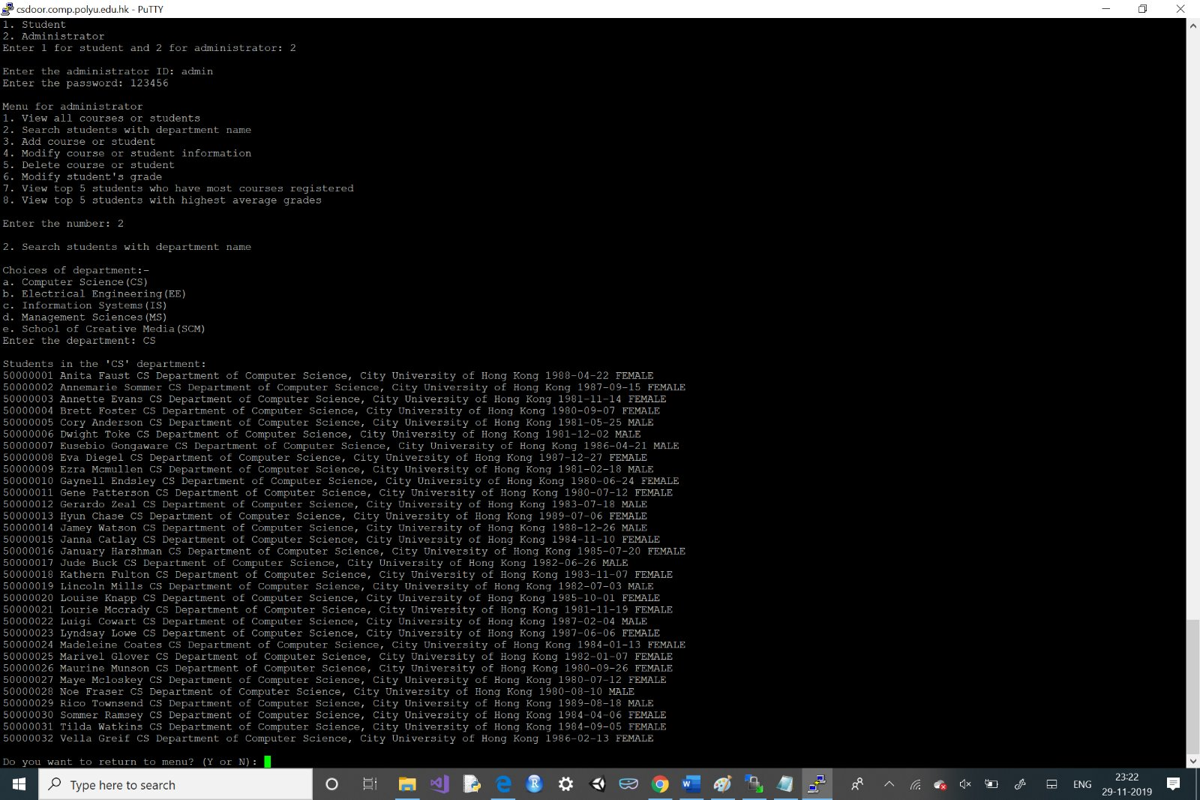
User manual for (g)
For viewing the information of the students from a certain department, login as admin (user ID: admin, password: 123456).
Select option 2 for the above action. Then write the department code from any of these- CS, IS, MS, SCM, EE.

Slide 21
User manual for part h)
(h) An administrator should be able to add a new course or student to the system.
Login to the system as administrator (Input 2 when the program starts)
Select option 3 to add course or student
Input ‘a’ for adding course or ‘b’ for adding student
Input ‘Y’ to return to menu for administrator

Slide 22
User manual for part h)
Add course
Input the course ID - If the course already exists, the user need to input course ID again
Input -1 if the user wants to end the program
Input information for the course - Course title, staff name and section
The output will be showed
Input ‘Y’ to return to menu for administrator

Slide 23
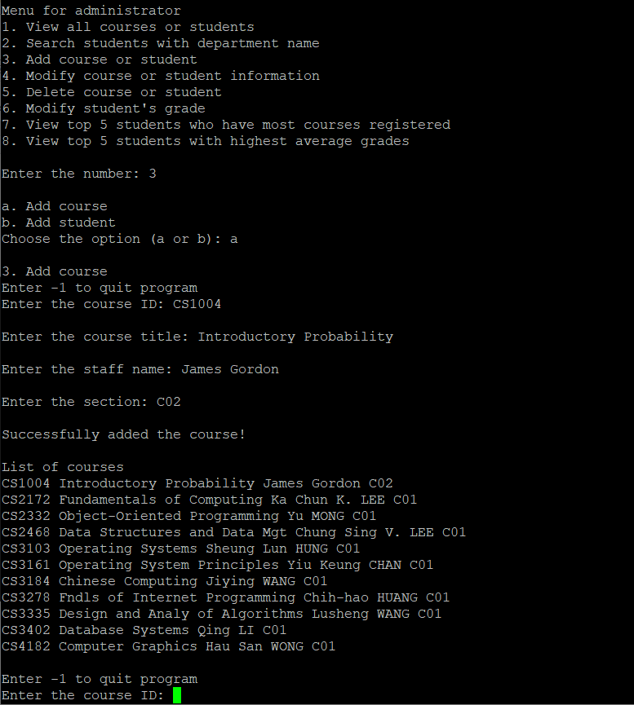
Demo for part (h)
The user select option 3 and input ‘a’ to add course
The user enter course ID, course title, staff name and section.
Course_id -> “AMA1004”
Course name -> “Introductory Probability”
Staff name -> “James Gordon”
Section -> “C02”

Slide 24
User manual for part h)
Add student
Input the student ID - If the student already exists, the user need to input student ID again
Input -1 if the user wants to end the program
Input information for the student - Student name, department, address, birthdate and gender
The output will be showed
Input ‘Y’ to return to menu for administrator

Slide 25
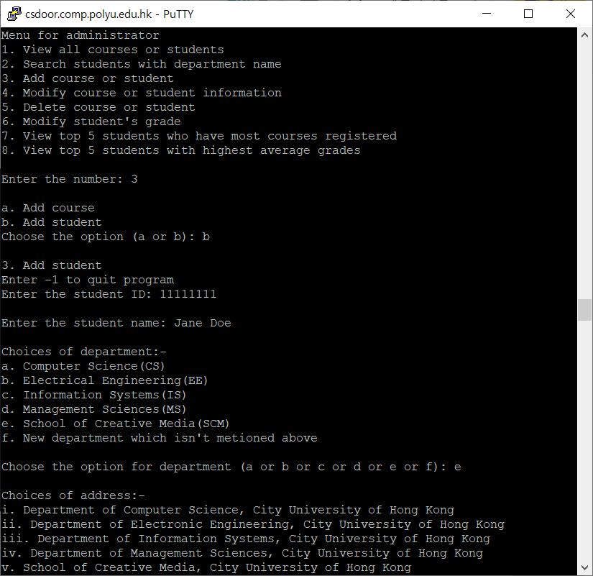
Demo for part (h)
The user select option 3 and input ‘b’ to add student
The user enter following information STUDENT_ID = 11111111
STUDENT_NAME = Jane Doe
DEPARTMENT : option ‘e’
ADDRESS : option ‘i’
BIRTHDATE = 2019-11-29
GENDER : option ‘b’

Slide 26
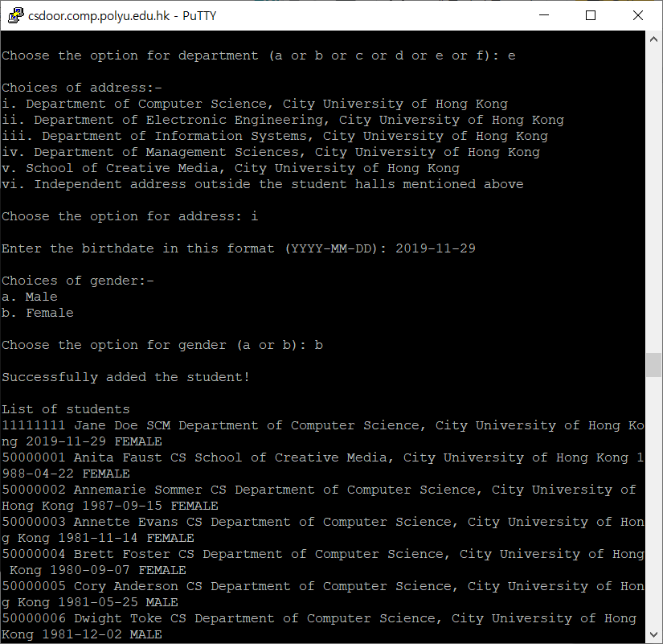
Demo for part (h)

Slide 27
User manual for part i)
(i) An administrator should be able to modify the information of a course or a student in the system.
Part (i) is used to update the records in the database. We are going to use
“ UPDATE STUDENTS SET …..”
Like "UPDATE STUDENTS SET STUDENT_ID = ? WHERE STUDENT_ID = ?" ( To modify the student id of students)
“ UPDATE COURSE SET ……”

Slide 28
User manual for part i)
To modify the information for part (i):
Log in the system as admin ( Input 2 after enter the program)
(the id : admin, password: 123456)
Select option 4 for modify the course or student information
Input 1 for modify the courses or 2 for the student
Input the course id or student id to be modified
Input a number for which information to be modify
Input the new value for the information
The information will be updated and a list after modification will be showed

Slide 29
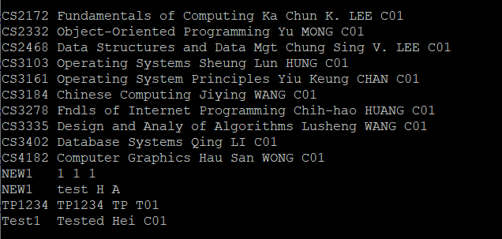
The list of courses before modification

Slide 30
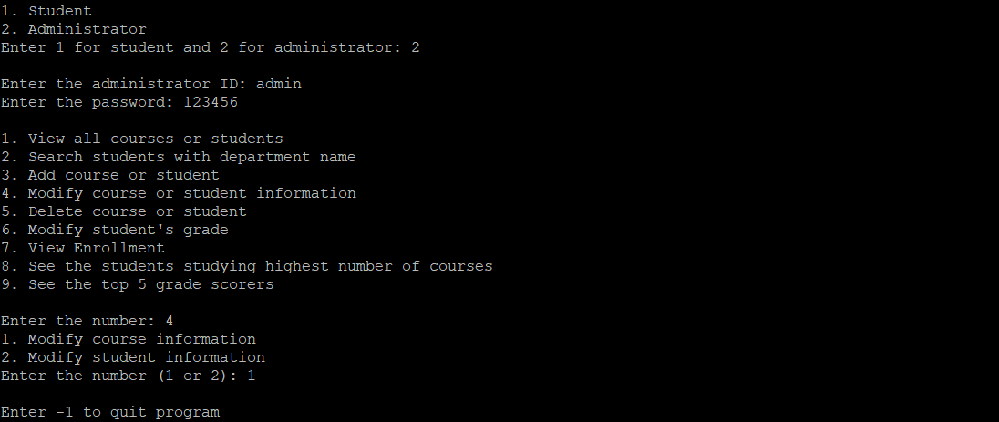
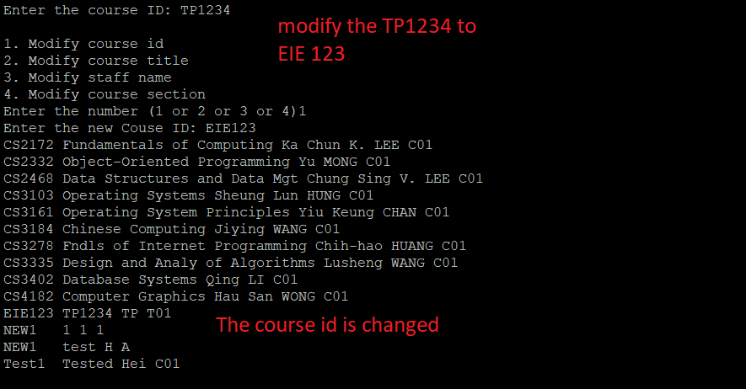
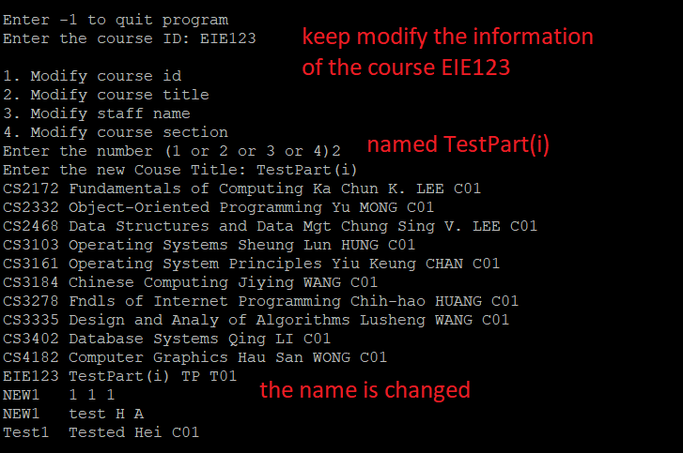
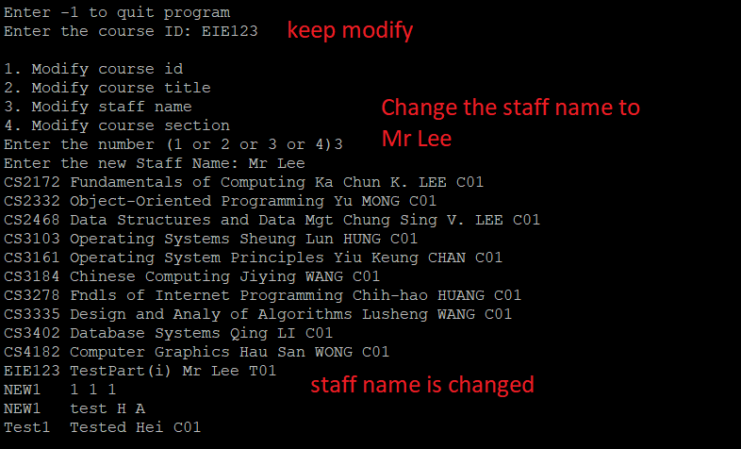
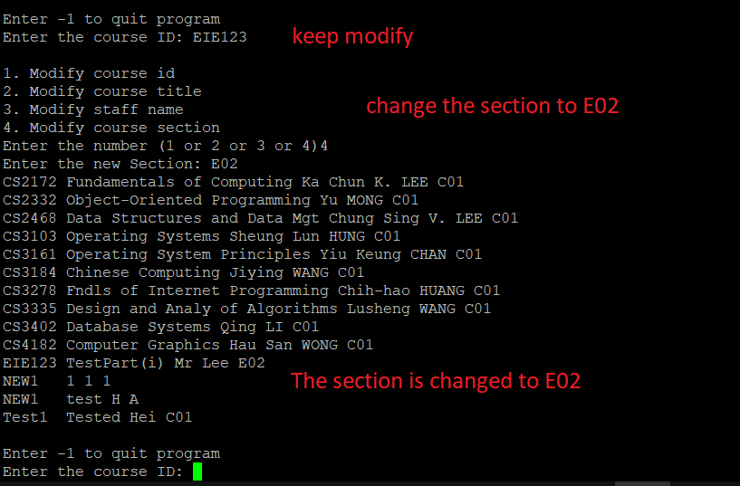
Demo 1 of part (i)
To change the Course_id : TP1234 to be EIE123
Course name to be TestPart(i) from TP1234
Staff name from TP to Mr Lee
Section from T01 to E02

Slide 31
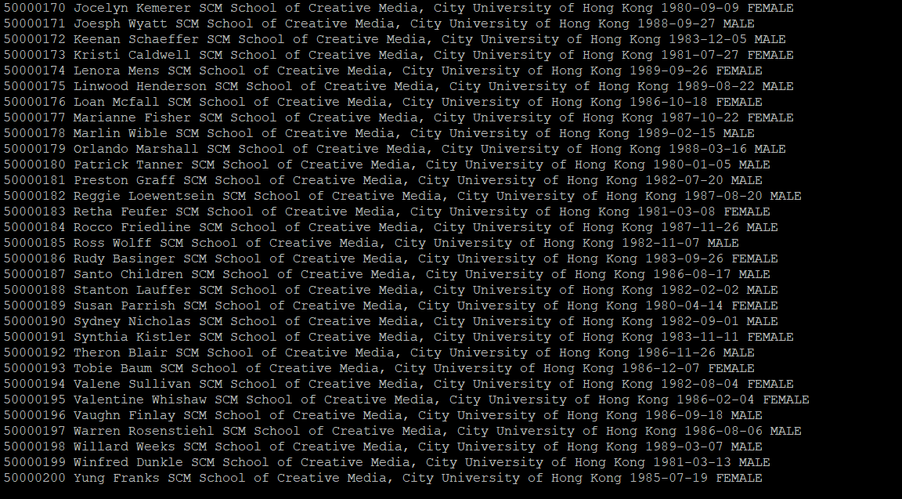
A part of the list of students before modification

Slide 32
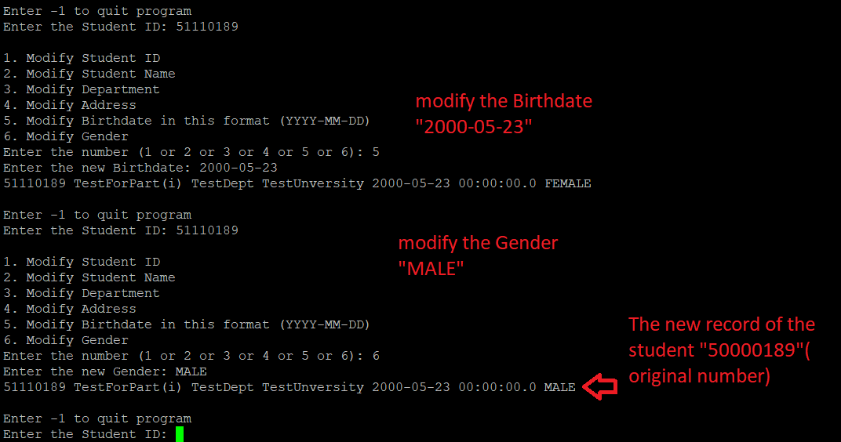
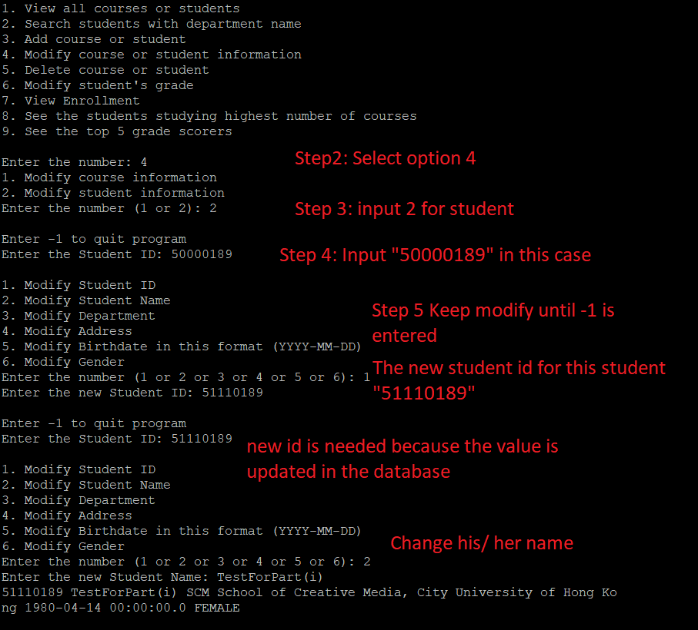
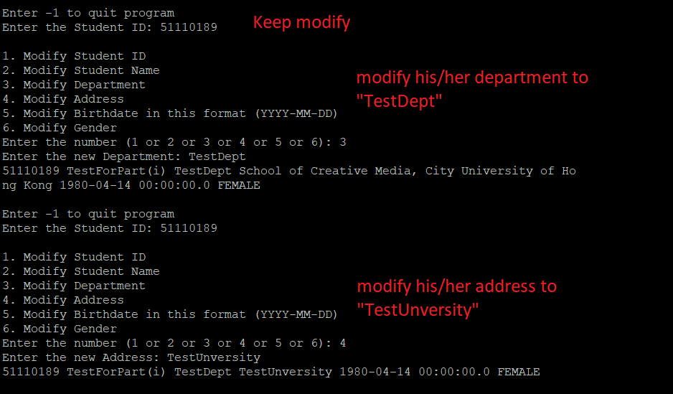
Demo 2 of part (i)
To modify the student
“50000189” to “51110189”
“Susan …” to “TestForPart(i)”
“SCM S…” to “TestDept”
“City ….” to “TestUnversity”
“1980-04-14” to “2000-05-23”
“FEMALE” to “MALE”

Slide 33
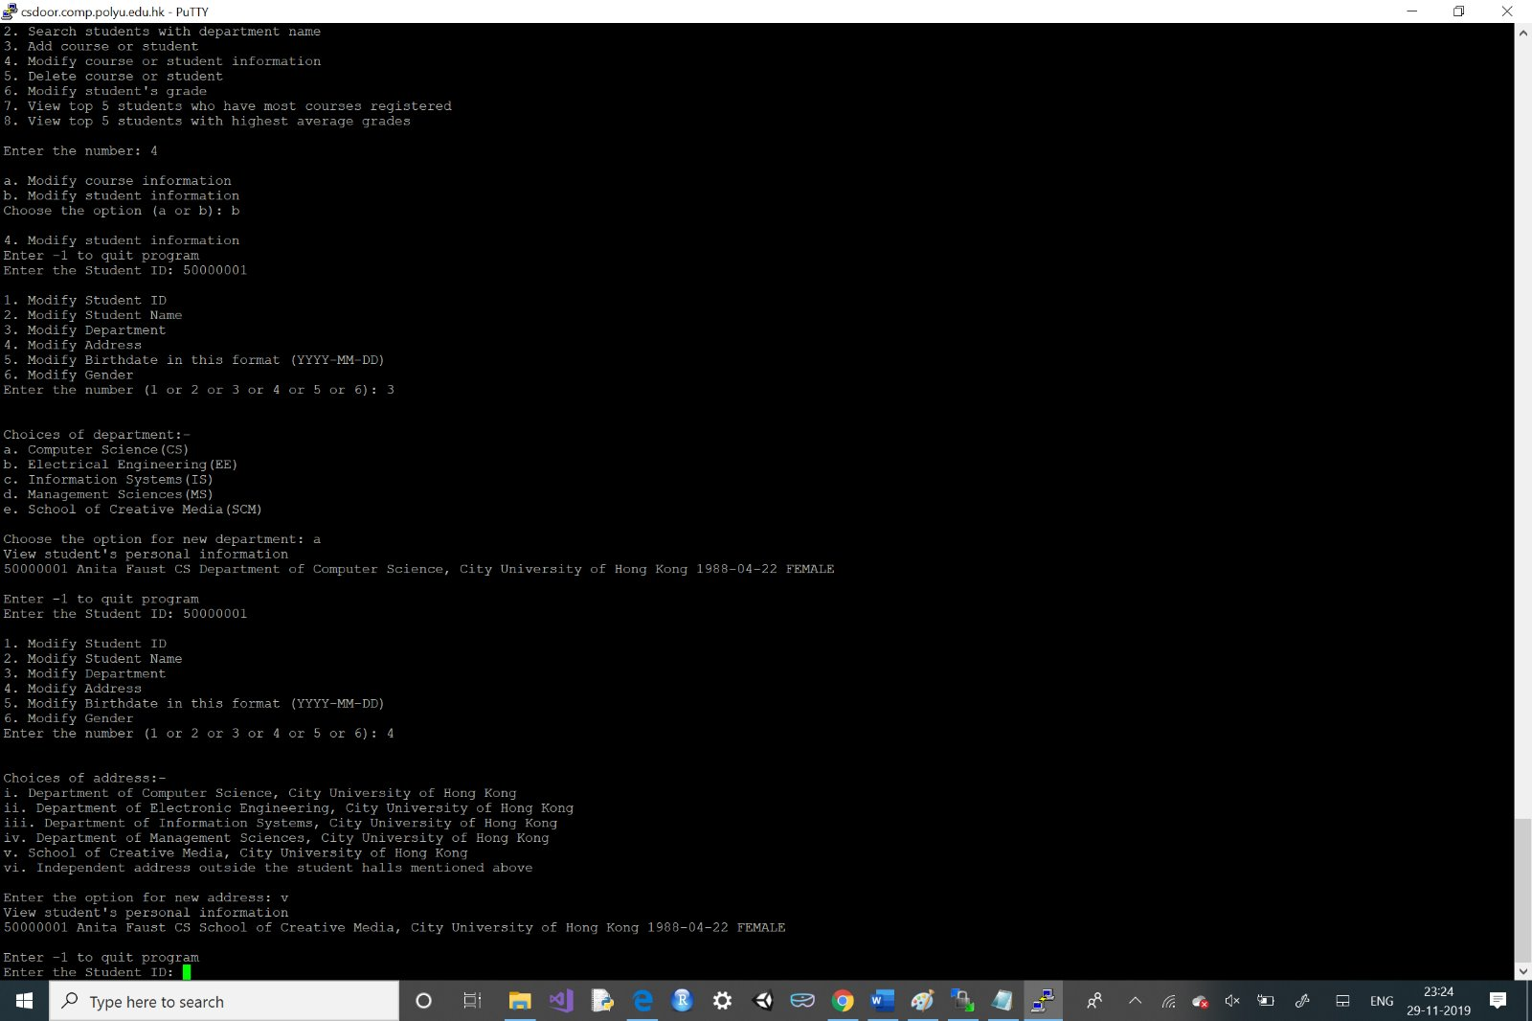
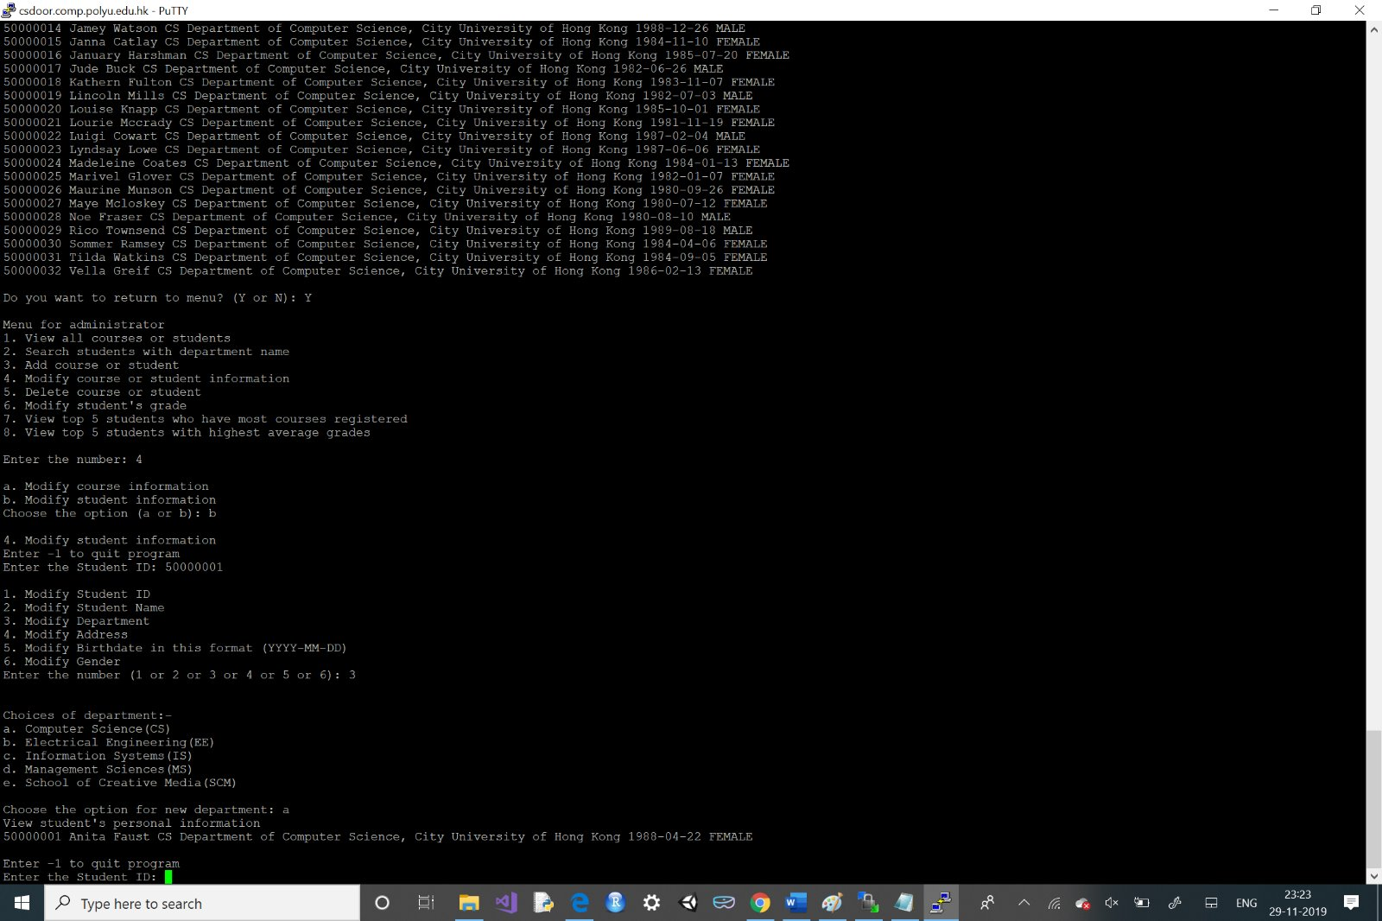
In part i), there are options for department and address. In address, there is flexibility to write own address if the user does not want to chose the mentioned addresses which are student halls. In these two cases, input the option like a,b,c or i,ii,iii.

Slide 34
User manual for part j)
(j) An administrator should be able to delete a course or a student from the system
Login to the system as administrator (Input 2)
Select option 5 to delete course or student
Input 1 for deleting course or 2 for deleting student
Input ‘Y’ to return to menu for administrator

Slide 35
User manual for part j)
Delete course
Input the course ID - If the course doesn’t exist, the user need to input course ID again
Input -1 if the user wants to end the program
The output will be showed
Input ‘Y’ to return to menu for administrator

Slide 36
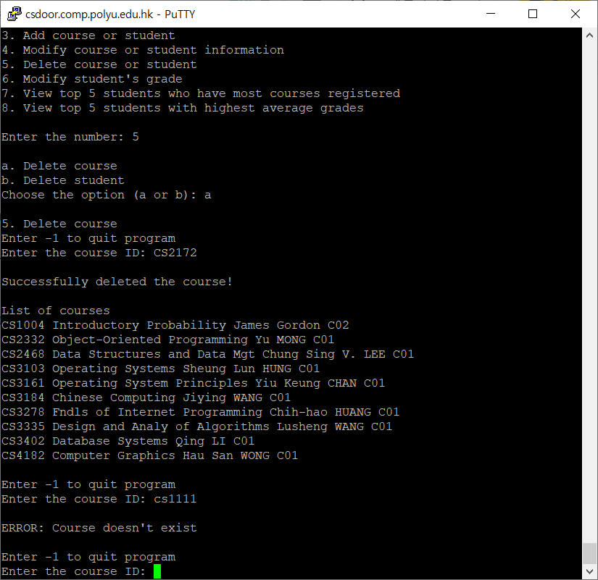
Demo for part (j)
The user select option 5 to delete the course or student.
The user input ‘a’ to delete the course
The user input course ID. COURSE_ID = CS2172
Error) The user input ‘cs1111’ as course id and the program shows error message

Slide 37
User manual for part j)
Delete student
Input the student ID - If the course doesn’t exist, the user need to input student ID again
Input -1 if the user wants to end the program
The output will be showed
Input ‘Y’ to return to menu for administrator

Slide 38
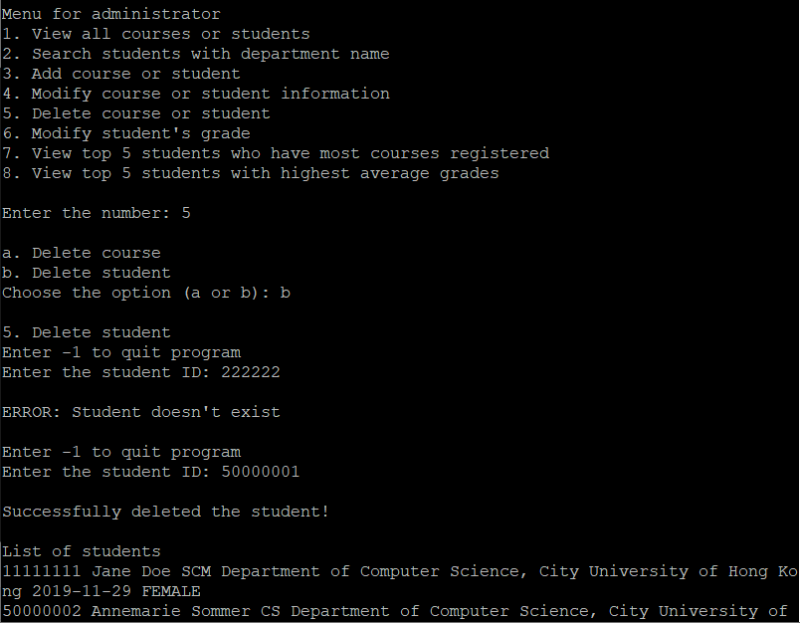
Demo for part (j)
The user select option 5 to delete the course or student.
The user input ‘b’ to delete the student
The user input student ID. STUDENT_ID = 50000001
Error) The user input ‘222222’ as studentid and the program shows error message

Slide 39
User manual for part k)
(k) An administrator should be able to modify the grade of a student for one of his/her registered courses.
Part (k), we need to modify the grade of students.
We needed the data “Student_id” and “Course_id”, so that we can update the information of “Grade” of Student by input.
The target SQL to be run
“UPDATE ENROLLMENT SET GRADE = ? WHERE STUDENT_ID = ? AND COURSE_ID = ?"

Slide 40
User manual for part k)
To modify the Grade of student:
Log in the system as admin
Select option 6 for modify the student’s grade
Input the Student_id that the student that we wanted to modify
Input the Course_id that the student took and we want to modify his/her grade
Input the new value for his/her Grade ( 0-100)
The record in the table “ENROLLMENT” will be updated
A list of the enrollment records after updated will be showed

Slide 41
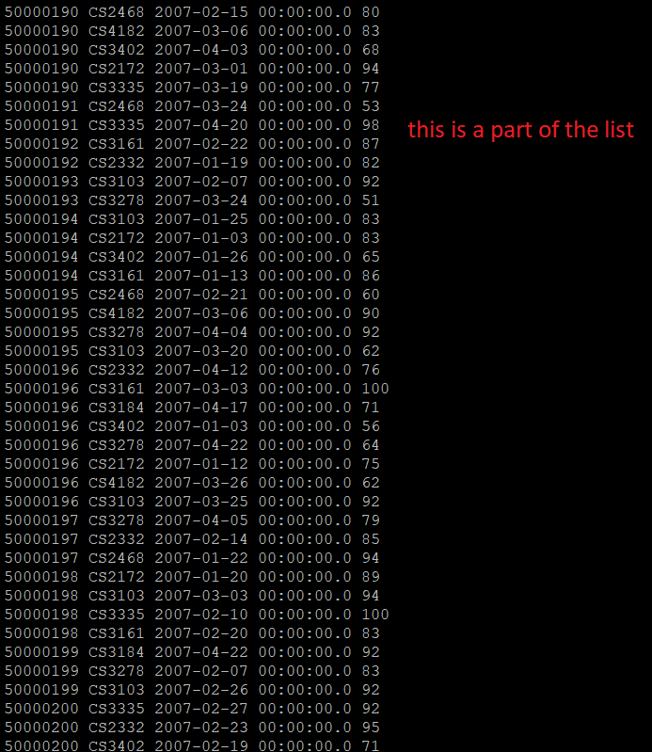
A part of the list of enrollment before modification

Slide 42
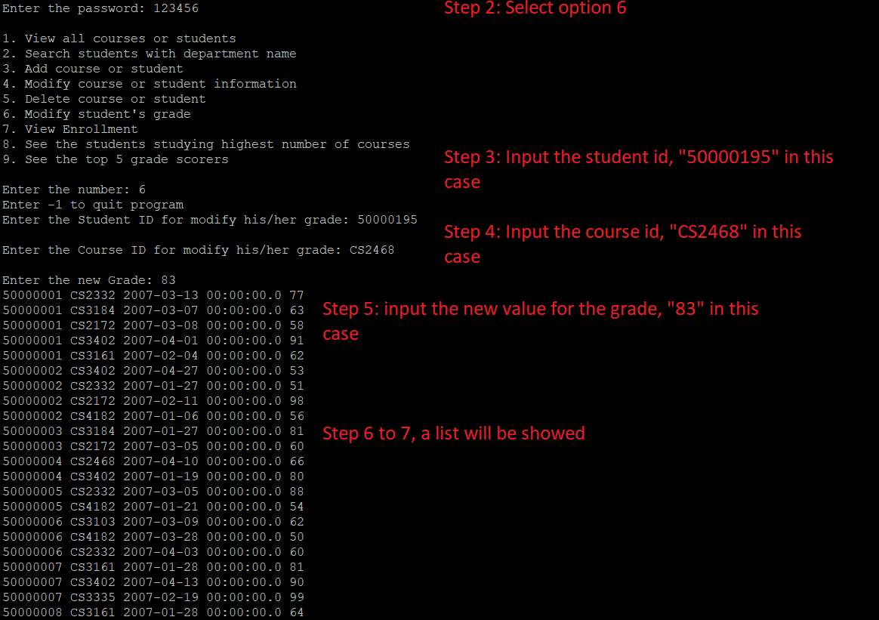
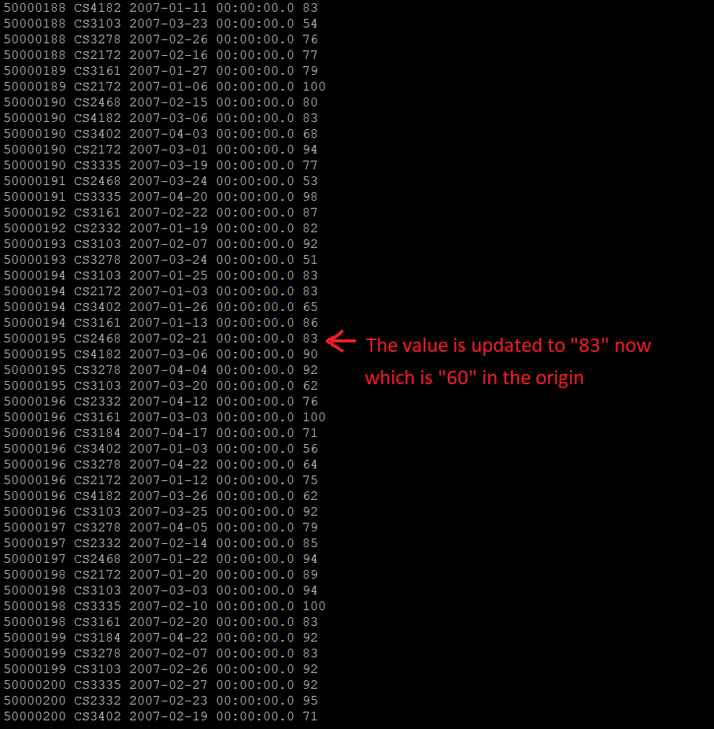
Demo of part (k)
To change the Course
“CS2468” which took by student “50000195”
his/her grade is “60” before.
We modify it to “83”

Slide 43
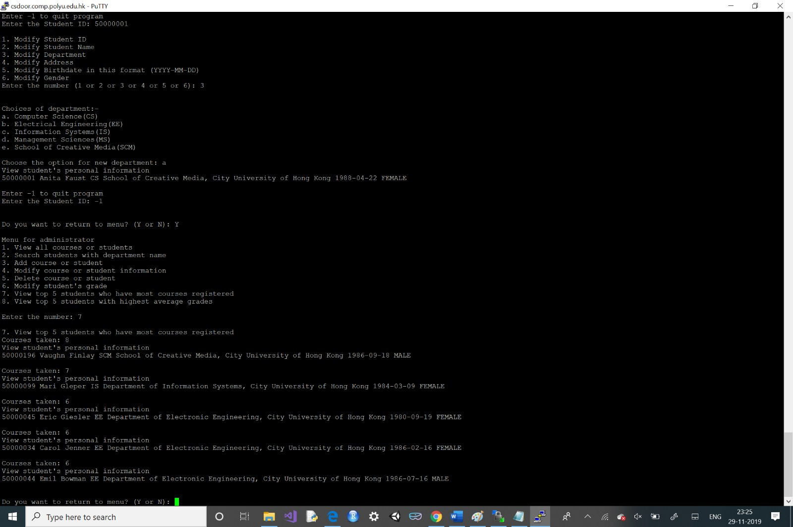
User manual for l)
For viewing the information of those students who have taken the highest number of courses, login as admin (user ID: admin, password: 123456).
Select option 7 for viewing the above stated information.

Slide 44
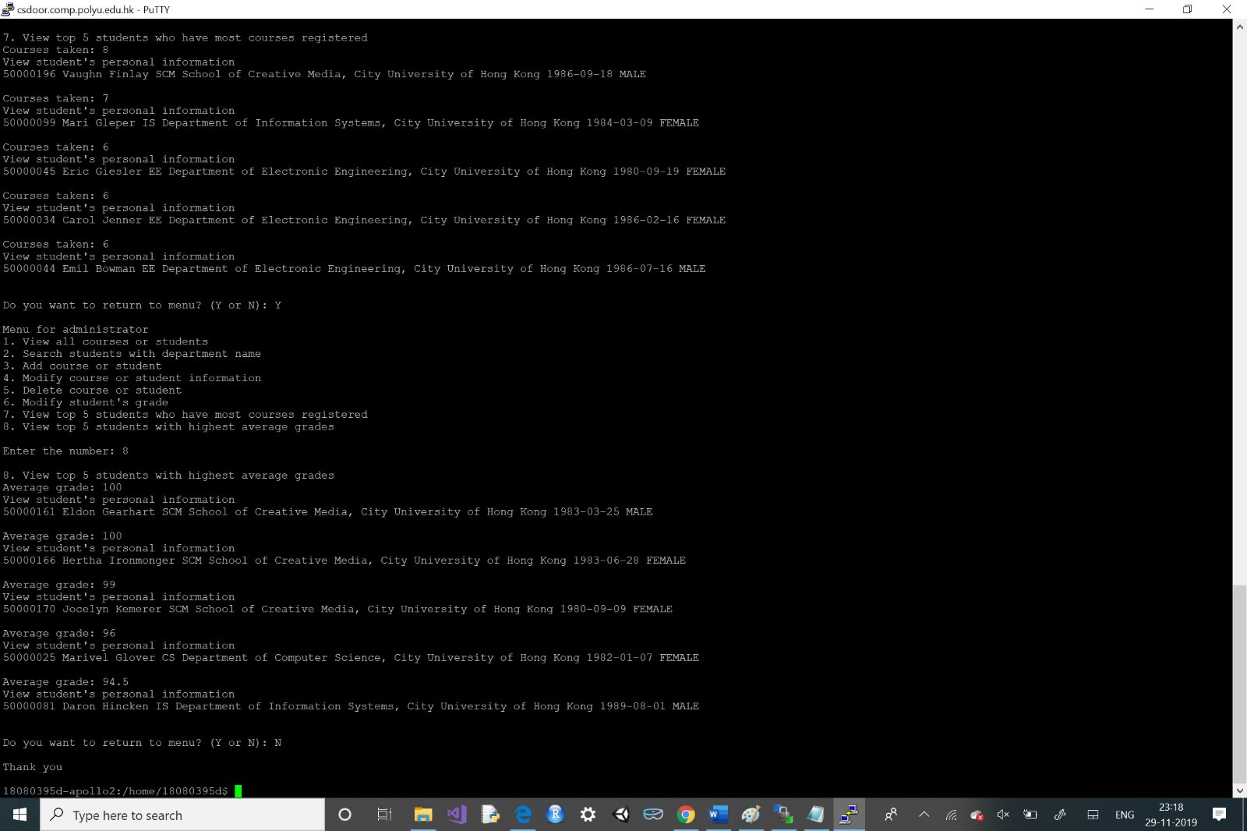
User manual for m)
For viewing the information of those students who have the highest average grades, login as admin (user ID: admin, password: 123456).
Select option 8 for viewing the above stated information.

Slide 45
Team member’s work
Minkyung LEE
Part a), b), c), d), h), and j) source code
User manual of a), b), c), d), h), and j)
Demonstration of a), b), c), d), h), and j)
Code editing

Slide 46
Team member’s work
Lee Ming Hei
Brief introduction of this project
Part f), i) and k) source code
User manual of part f), i), k)
Demonstration of part f), i), k)
Code editing

Slide 47
Team member’s work
Sweta Das
Part a)(adding password) e)/i), g), l) and m) source code
User manual of part e)/i), g), l), m)
Demonstration of part e)/i), g), l), m)
Code editing

